Slide 1
Integrated Circuits
Decoder
Multiplexer
Registers
Shift Registers
Binary Counter

Slide 4
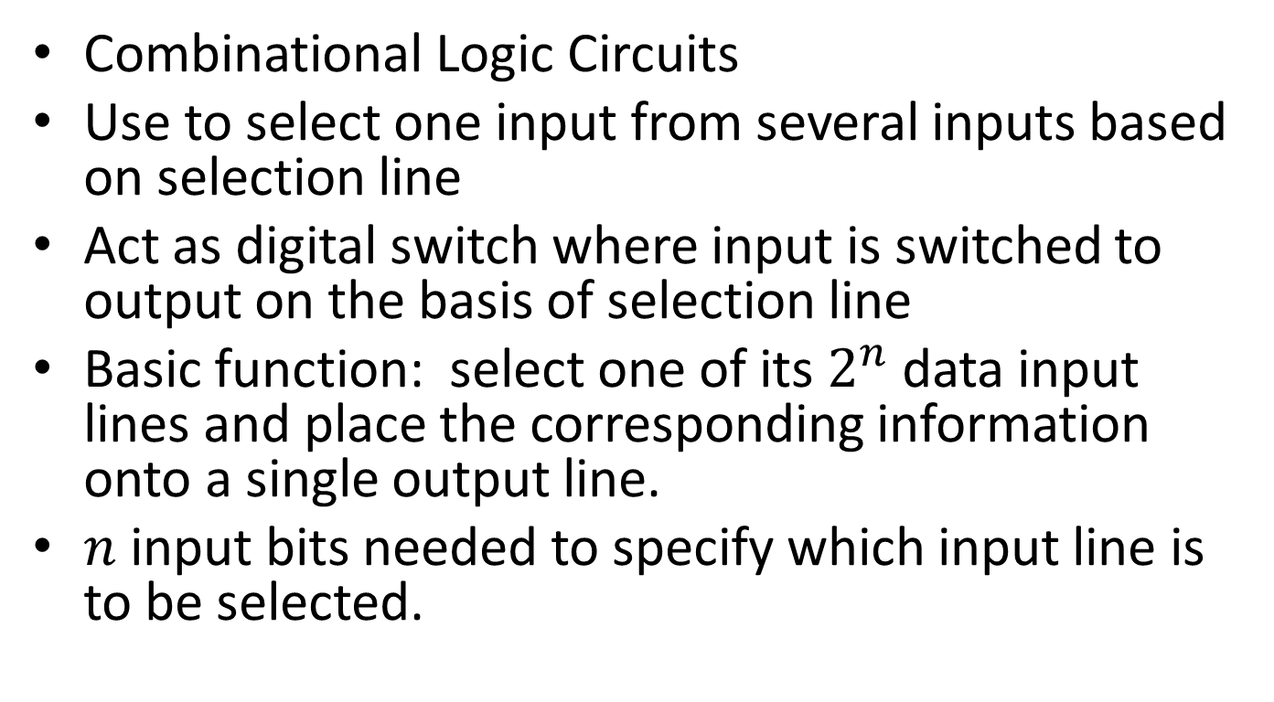
Multiplexer
Combinational Logic Circuits
Use to select one input from several inputs based on selection line
Act as digital switch where input is switched to output on the basis of selection line
Basic function: select one of its $2^{n}$ data input lines and place the corresponding information onto a single output line.
$n$ input bits needed to specify which input line is to be selected.

Slide 5
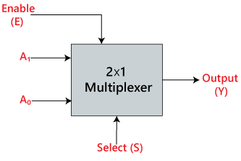
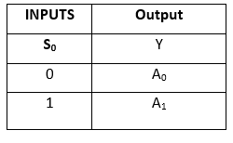
2X 1 Multiplexer

Slide 6
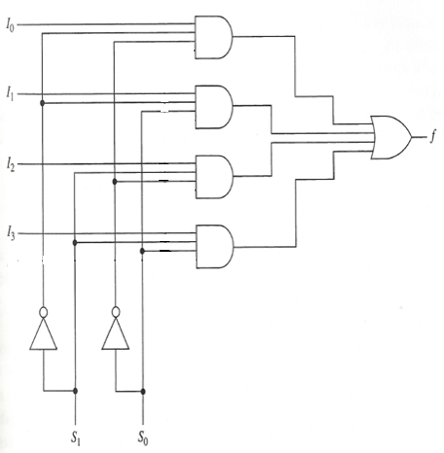
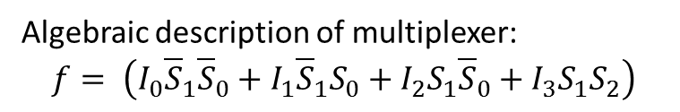
4X1
Algebraic description of multiplexer:
$$f= \left(I_{0}{\overline{S}}_{1}{\overline{S}}_{0}+I_{1}{\overline{S}}_{1}S_{0}+I_{2}S_{1}{\overline{S}}_{0}+I_{3}S_{1}S_{2}\right)$$

Slide 7
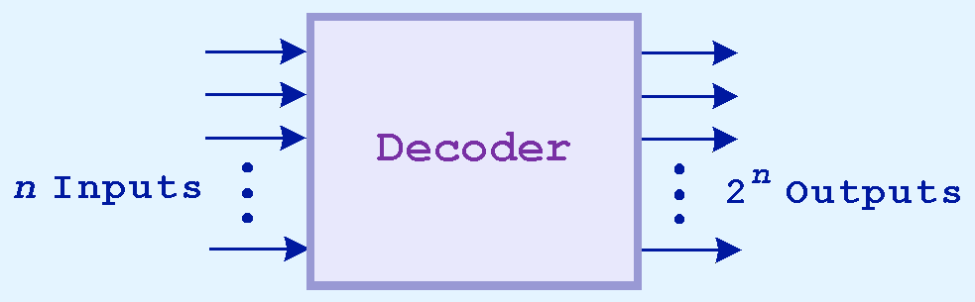
Combinational Circuits : Decoder
Decoders are another important type of combinational circuit.
Among other things, they are useful in selecting a memory location according a binary value placed on the address lines of a memory bus.
Address decoders with n inputs can select any of 2^{n} locations.

Slide 8
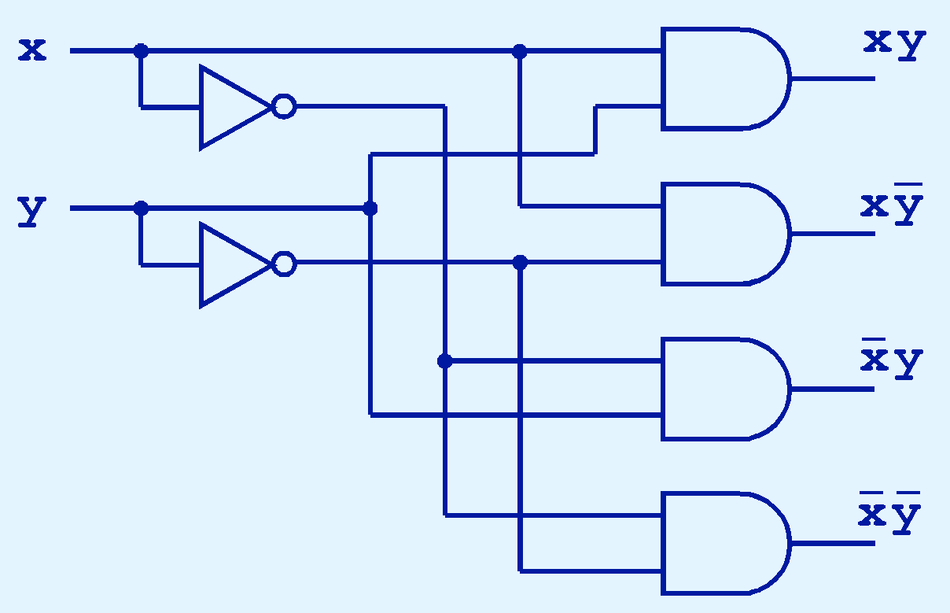
Combinational Circuits: Decoder
This is what a 2-to-4 decoder looks like on the inside.

Slide 9
Registers
A Register is a group of binary storage cells suitable for holding binary information.
A flip flop can hold one bit.
To store n-bit , n flip flops are required (n-bit register)
Each combination of stored information is known as the state or content of the register.
Addition to flip flop, a register may have combinational gates that perform certain data processing.

Slide 10
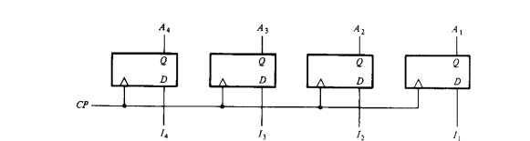
4 bit register
4 D type flip flop
a common clock pulse input
4 outputs can be sampled to obtain the information presently stored in the register
The registers are sensitive to the pulse duration and the register enabled for as long as CP=2.
The register responded to the pulse duration is commonly called gated latch.
A group of Flip flop sensitive to the pulse duration are called latches

Slide 11
Register
Transfer of the new information into register is referred to as Loading.
if the all bit are loaded in register than it called loading is done in parallel.

Slide 12
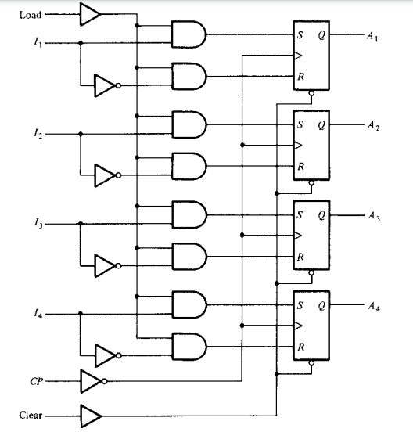
4 bit parallel loading

Slide 13
Shift Registers
Shift register: Registers that are capable of moving information upon the occurrence of a clock-signal.
The logical configuration of a shift register consists of a chain of flip flops connected in cascade.
Unidirectional
bidirectional

Slide 14
Operation on shift register
Load
Reset
Shift left
Shift right

Slide 15
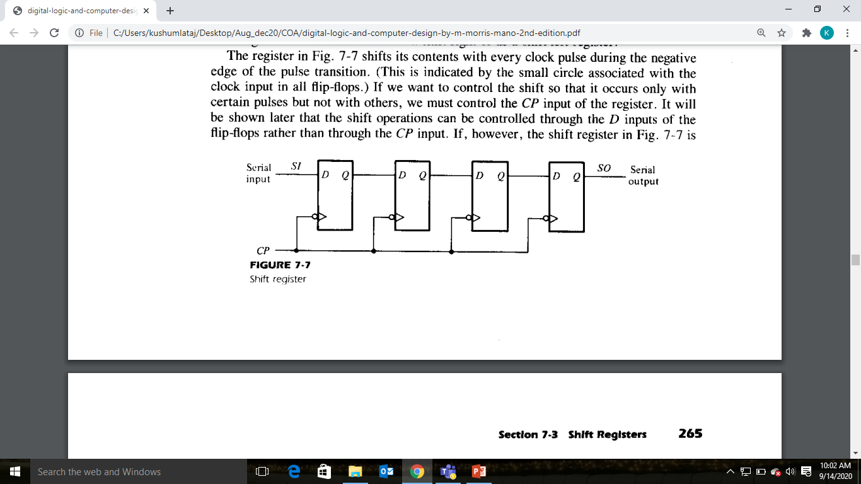
Shift Register

Slide 16
Shift Register
Unidirectional shift register can function either shift-right or shift left.
Serial input determines what goes into the leftmost flip flop during the shift.
The serial output is taken from the output of its contents to the right.

Slide 17
Shift Register
Shift Registers are used for data storage or for the movement of data and are therefore commonly used inside calculators or computers to store data such as two binary numbers before they are added together, or to convert the data from either a serial to parallel or parallel to serial format.
The individual data latches that make up a single shift register are all driven by a common clock ( Clk ) signal making them synchronous devices.
Shift register IC’s are generally provided with a clear or reset connection so that they can be “SET” or “RESET” as required.

Slide 18
Shift Registers
Generally, shift registers operate in one of four different modes
Serial-in to Parallel-out (SIPO) - the register is loaded with serial data, one bit at a time, with the stored data being available at the output in parallel form.
Serial-in to Serial-out (SISO) - the data is shifted serially “IN” and “OUT” of the register, one bit at a time in either a left or right direction under clock control.
Parallel-in to Serial-out (PISO) - the parallel data is loaded into the register simultaneously and is shifted out of the register serially one bit at a time under clock control.
Parallel-in to Parallel-out (PIPO) - the parallel data is loaded simultaneously into the register, and transferred together to their respective outputs by the same clock pulse.

Slide 19
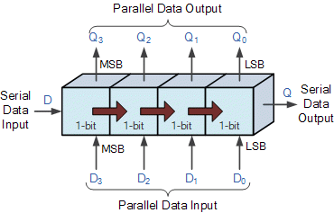

Slide 20
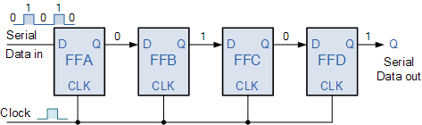
Serial-in to Serial-out (SISO) Shift Register

Slide 21
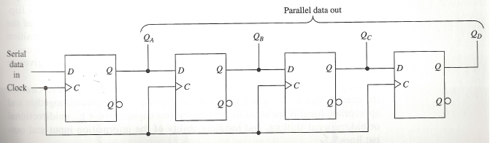
Serial-in, Parallel-out Unidirectional Shift Register

Slide 22
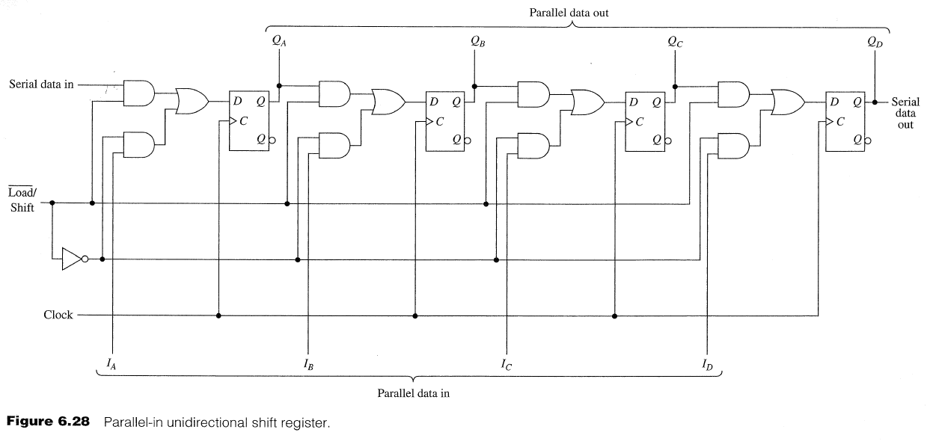
Parallel-in, Parallel-out Unidirectional Shift Register

Slide 23
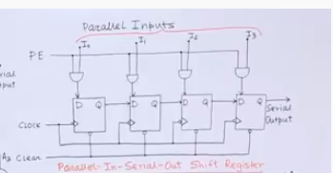
Parallel –In-Serial-Out

Slide 24
Counters
Counters is a digital device to count number of pulses.
Primary purpose is to produce a specified output pattern sequence.
Also called a pattern generator
Each stored 0/1 combination is called the state of the counter.
N-bit counter require N flip flop.
The order in which states appear is referred to as its counting sequence.
Depicted by a directed graph called a state diagram.
Counter come in two categories
Asynchronous : the flip-flop output transition serves as a source for triggering other flip flop. Example Ripple Counter
Synchronous : the input pulse are applied to all Clock pulse inputs of all flip- flops

Slide 25
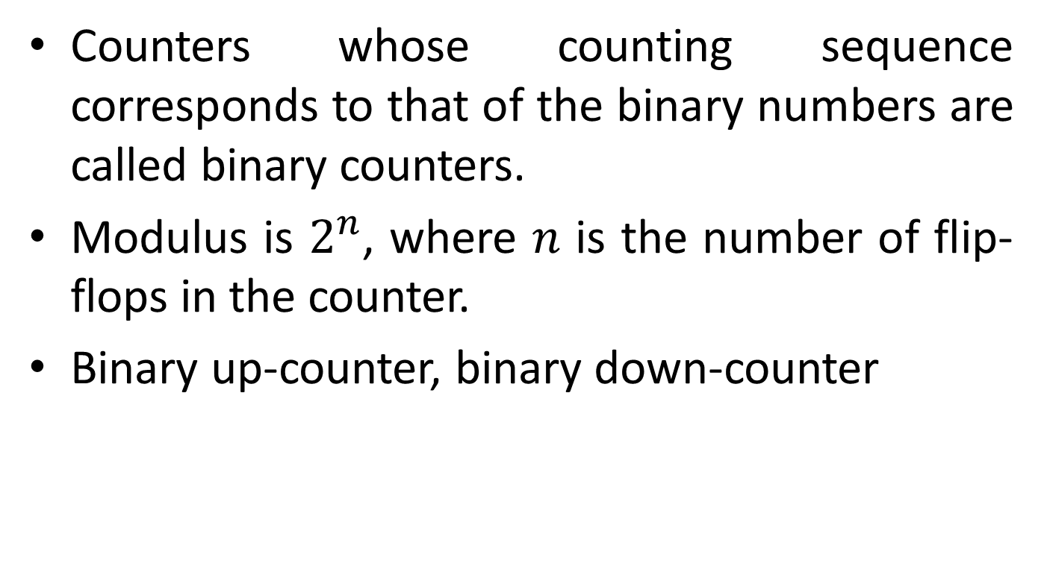
Binary Ripple Counters
Counters whose counting sequence corresponds to that of the binary numbers are called binary counters.
Modulus is $2^{n}$, where $n$ is the number of flip-flops in the counter.
Binary up-counter, binary down-counter

Slide 26
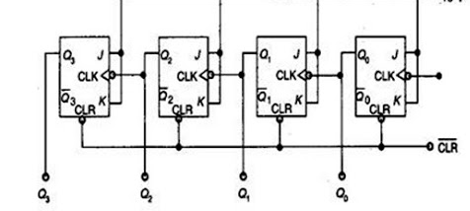
4-bit Binary Ripple Counter
A binary Counter consists of a series of complementing flip flops , with the output of each flip-flop connected to CP input of the nest higher order flip-flop.

Slide 27
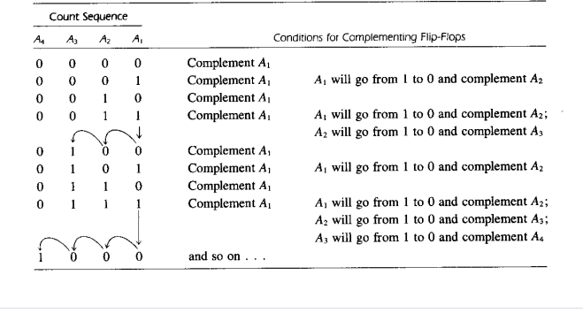
Count Sequence for binary ripple counter

Slide 28
Counter
Down Counter: A binary counter with the reverse count is called a binary counter.
Counter is decremented by 1 with every input count pulse.
Up Counter: A binary counter with the increment is called up counter.

